Slide 1

DSO 530 Final Project
Zhuoqun SHENG
He YOU

Slide 2
Background, Observations, and Procedures
Assumptions and Variables
Analysis into IMDb Score
Analysis into Gross
Conclusions and Recommendations

Slide 3
Background, Observations, and Procedures
IMDb data for 5000 movies was exported from Kaggle.com
2589 unique, post-2000 U.S. movie titles were analyzed
The goal is to analyze the relationship between gross and IMDb score with the other variables.

Slide 4
Assumptions & Variables
Assumptions
Gross reflects popularity in movie market
IMDb score reflects public praise
Dependent variables: IMDb score and gross
A categorical dependent variable was created using IMDB score – if IMDb_score >= 7, value = 1, otherwise value = 0.
The threshold of 7 was selected because group members would be more likely to watch a movie if it had a score of 7+.
Independent variables: budget (numerical), duration (numerical), movie Facebook likes (numerical), actor 1-3 Facebook likes (numerical), cast Facebook likes (numerical), Director Facebook likes (numerical), number of critics (numerical), number of voters (numerical), genre (categorical), plot keywords (categorical), title year (numerical), actor 1-3 (categorical), director (categorical)

Slide 5
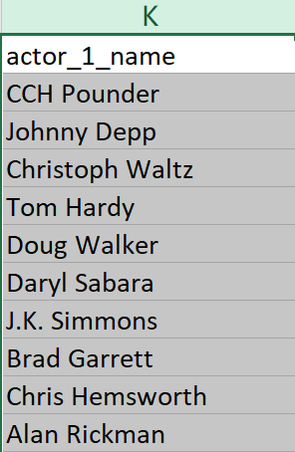
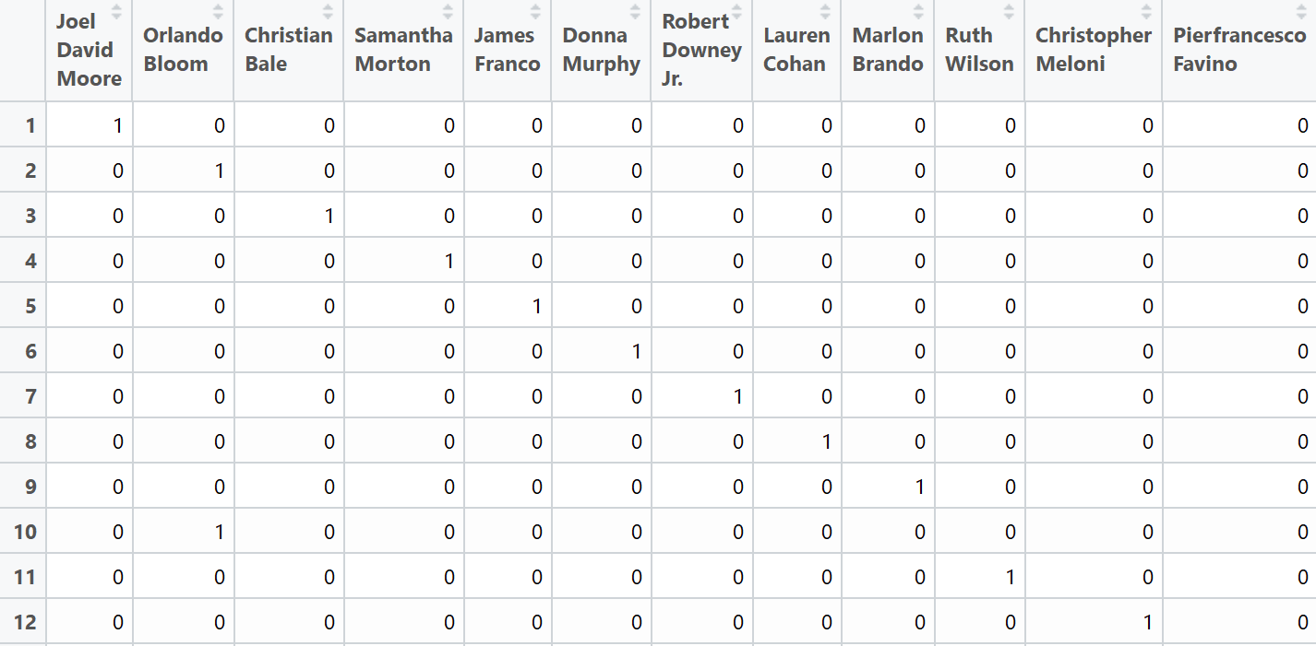
Procedure
Firstly, we separate the original variables “Keywords”, “Genres”, “Directors”, ”Actors” into several individual variables.
There are 23 genres, 3549 actors, 1445 directors, 5253 keywords in this dataset in total

Slide 6
Procedure
Secondly, we do some preparatory work
For example: (1) We calculate gross and budget in million, so that
budget will not be over-valued in this model.
(2)75% of whole dataset is regarded as train_data while
rest of them is used as test_data
Thirdly, we analyze how numerical variables influence the IMDb_score and Gross
Logistic regression, LDA, QDA and KNN methods are used to
measure the IMDb_score whether higher than 7.
Linear regression is used to measure the Gross

Slide 7
Procedure
Fourthly, we analyzed how genres, directors, actors and keywords impact on IMDb score and gross
Ridge regression is used to compare individual variable
Lasso regression is used to identify which variables have significant
influence on IMDb score and gross
Finally, we made comprehensive analysis
Data visualization is used to identify which particular genre, director or
actor is special

Slide 8
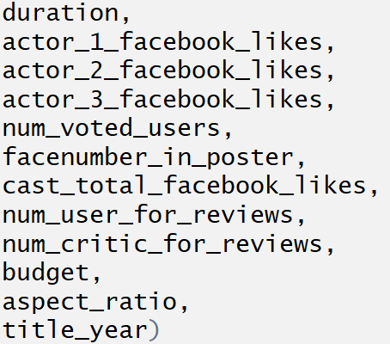
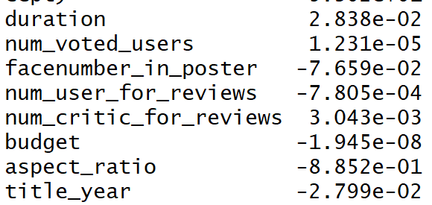
Analysis into IMDb Score
Numerical variables
LDA model is best. The misclassification error is 0.141
Nothing related to Facebook
Recent year tend to have lower IMDb score
Notes:
We assume that gross has relationship with both production and marketing process, thus gross is probably affected by factors including budget, duration and popularity of director and cast (which is reflected by Facebook likes). Additionally, gross is also affected by word-of-mouth marketing online, which could be reflected through IMDb score, number of voted users and number of critics for reviews.

Slide 9
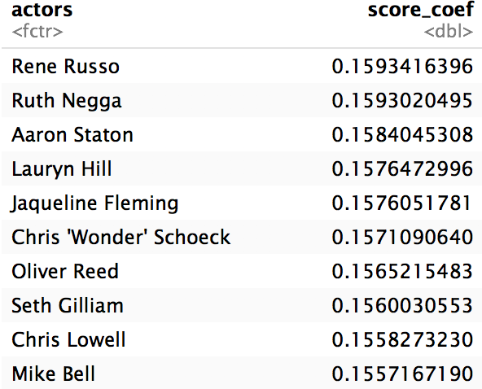
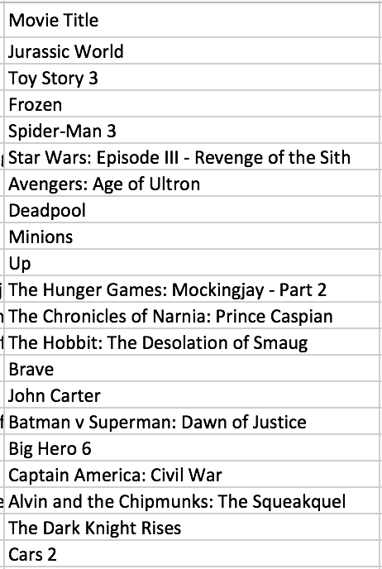
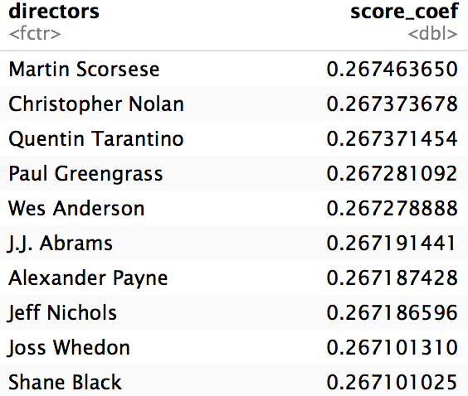
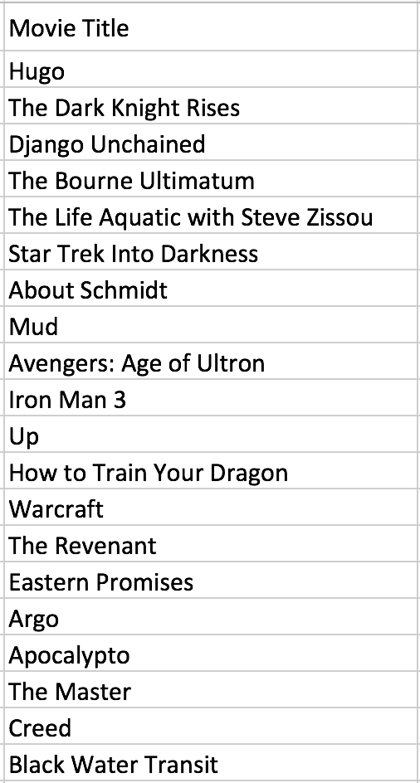
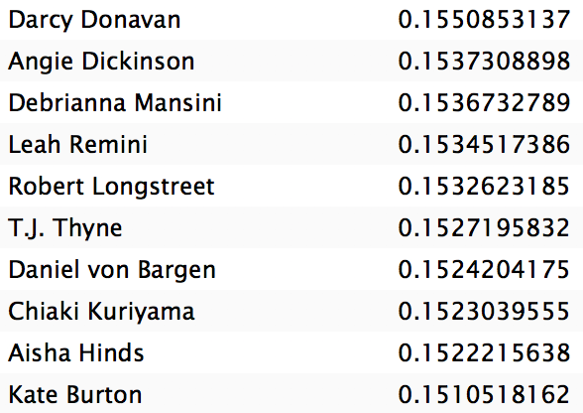
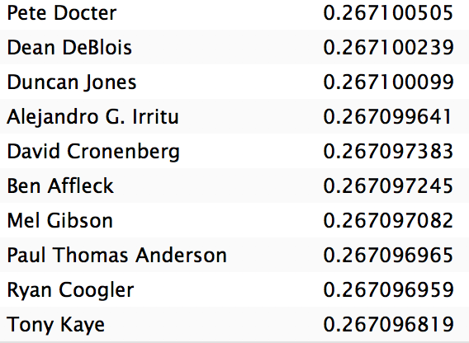
Analysis into IMDb Score
Directors and Actors –Top 20 Score identified by Ridge model
Notes:
We assume that gross has relationship with both production and marketing process, thus gross is probably affected by factors including budget, duration and popularity of director and cast (which is reflected by Facebook likes). Additionally, gross is also affected by word-of-mouth marketing online, which could be reflected through IMDb score, number of voted users and number of critics for reviews.

Slide 10
Analysis into IMDb Score
Actors – Highest Score
Notes:
We assume that gross has relationship with both production and marketing process, thus gross is probably affected by factors including budget, duration and popularity of director and cast (which is reflected by Facebook likes). Additionally, gross is also affected by word-of-mouth marketing online, which could be reflected through IMDb score, number of voted users and number of critics for reviews.

Slide 11
Analysis into IMDb Score
Using the lasso regression, we could identify the ratio of variables have signification impact on the dependent variables.
21.7% of genres have significantly impact on IMDb score.
None of actors, keywords, directors have significantly impact on IMDb score.
That may because we use IMDb score as a categorical variable rather than numerical. This result could be improved if we change the attribute of the IMDb score in further research.
Notes:
We assume that gross has relationship with both production and marketing process, thus gross is probably affected by factors including budget, duration and popularity of director and cast (which is reflected by Facebook likes). Additionally, gross is also affected by word-of-mouth marketing online, which could be reflected through IMDb score, number of voted users and number of critics for reviews.

Slide 12
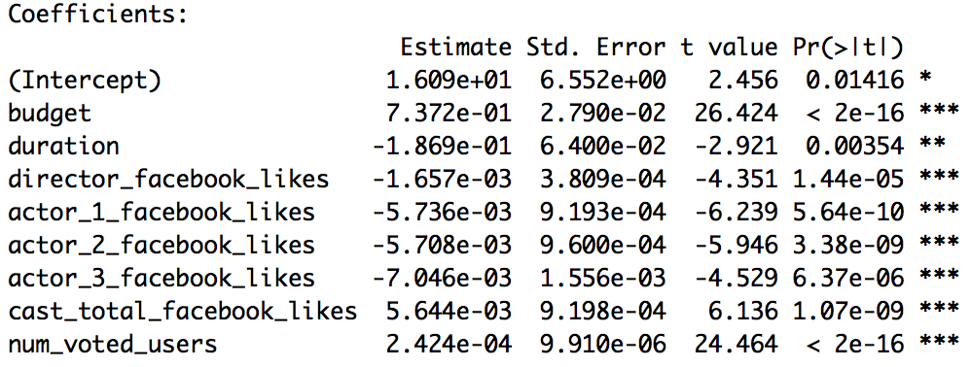
Analysis into Gross
Linear Regression Analysis
Variables:
budget, duration, title year, director Facebook likes, actor 1 Facebook likes, actor 2 Facebook likes, actor 3 Facebook likes, cast total Facebook likes, movie Facebook likes, number of voted users, number of critic for reviews, face number in poster.
Budget has strong positive effects on gross.
Duration has an obvious negative relationship with gross.
Facebook likes of staff seems to have little to do with gross.
Number of voted users has a slight positive relationship with gross.
Notes:
We assume that gross has relationship with both production and marketing process, thus gross is probably affected by factors including budget, duration and popularity of director and cast (which is reflected by Facebook likes). Additionally, gross is also affected by word-of-mouth marketing online, which could be reflected through IMDb score, number of voted users and number of critics for reviews.

Slide 13
Analysis into Gross
Genres
Genre | Coefficient | Keyword | Coefficient
Adventure | 0.54039629 | iron man | 1.7325129
Animation | 0.33085388 | velociraptor | 1.19511312
Action | 0.30981386 | experiment gone wrong | 1.19503439
Fantasy | 0.22553026 | disaster film | 1.19489973
Sci-Fi | 0.20380205 | physical appearance | 1.14607346
History | 0.15351692 | dc comics | 1.09140279
War | 0.13753685 | teddy bear | 0.95738073
Biography | 0.08883533 | day care | 0.95737811
Sport | 0.03640468 | tentacle | 0.94949297
Family | 0.03503043 | goblin | 0.92559591
News | 0.03409123 | snowman | 0.91979423
Mystery | 0.01213348 | sister love | 0.91976416
Short | 0 | self survival | 0.90420161
Romance | -0.00106688 | fight to the death | 0.90417362
Music | -0.04436885 | terrorist plot | 0.82381366
Musical | -0.04822326 | lawlessness | 0.82378445
Thriller | -0.05213305 | imprisonment | 0.82369967
Crime | -0.05813061 | death of child | 0.80385281
Comedy | -0.0647272 | missile attack | 0.79208552
Western | -0.14187135 | human bomb | 0.7920397
According to Lasso model, 78.26% genres and 1.24% keywords contribute to gross
Notes:
We assume that gross has relationship with both production and marketing process, thus gross is probably affected by factors including budget, duration and popularity of director and cast (which is reflected by Facebook likes). Additionally, gross is also affected by word-of-mouth marketing online, which could be reflected through IMDb score, number of voted users and number of critics for reviews.

Slide 14
Analysis into Gross
Directors – Highest Gross
According to Lasso model, 11.54% directors and 1.63% actors contribute to gross.
Director | Coefficient | Actors | Coefficient
Colin Trevorrow | 7.307043342 | Anthony Reynolds | 1.400930145
Lee Unkrich | 4.420763514 | Conrad Vernon | 1.378292484
Chris Buck | 4.24737759 | Don Rickles | 1.335078496
Sam Raimi | 4.099274173 | Omar Sy | 1.27030978
George Lucas | 3.998223279 | Maurice LaMarche | 1.201861892
Joss Whedon | 3.864177499 | Livvy Stubenrauch | 1.201848519
Tim Miller | 3.788397717 | Alan D. Purwin | 1.04722418
Kyle Balda | 3.459938788 | Lester Speight | 1.042884567
Pete Docter | 3.181569619 | Ed Skrein | 1.037281294
Francis Lawrence | 2.9211836 | Stefan Kapicic | 1.037272367
Andrew Adamson | 2.888433709 | Keir O'Donnell | 1.032398895
Peter Jackson | 2.473987788 | Leonard Roberts | 1.032380053
Mark Andrews | 2.258396103 | Billy Boyd | 1.006461543
Andrew Stanton | 2.132797309 | Kevin Dunn | 0.942740474
Zack Snyder | 2.130138218 | Orlando Bloom | 0.902153161
Don Hall | 2.07836302 | Zack Ward | 0.841528596
Anthony Russo | 2.077894329 | John Ratzenberger | 0.839564831
Betty Thomas | 2.04332642 | Jess Harnell | 0.835581957
Christopher Nolan | 2.039271466 | Willow Smith | 0.829381564
John Lasseter | 2.020873264 | James Coburn | 0.822328922
Notes:
We assume that gross has relationship with both production and marketing process, thus gross is probably affected by factors including budget, duration and popularity of director and cast (which is reflected by Facebook likes). Additionally, gross is also affected by word-of-mouth marketing online, which could be reflected through IMDb score, number of voted users and number of critics for reviews.

Slide 15
What will make the next blockbuster?
Cross-analysis

Slide 16
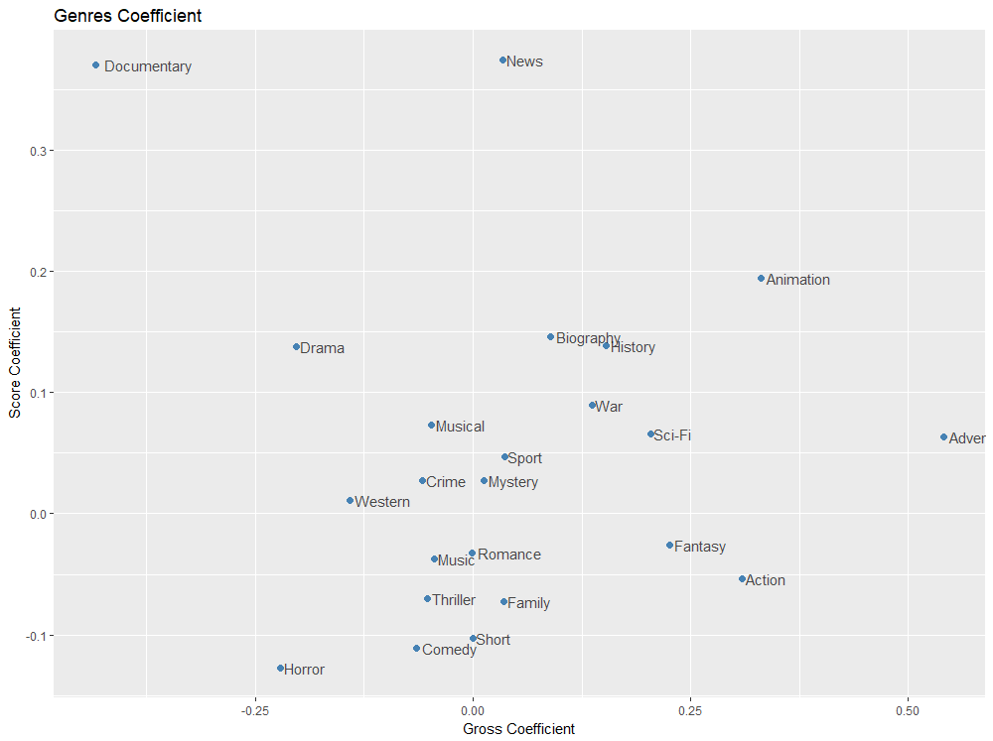
What genres will make the next blockbuster?
Animation is the most outstanding genre that behaves well both in gross profit and IMDb score.
Adventure, Sci-Fi, History and War, though have weaker positive impact on IMDb score, are also attractive genres.

Slide 17
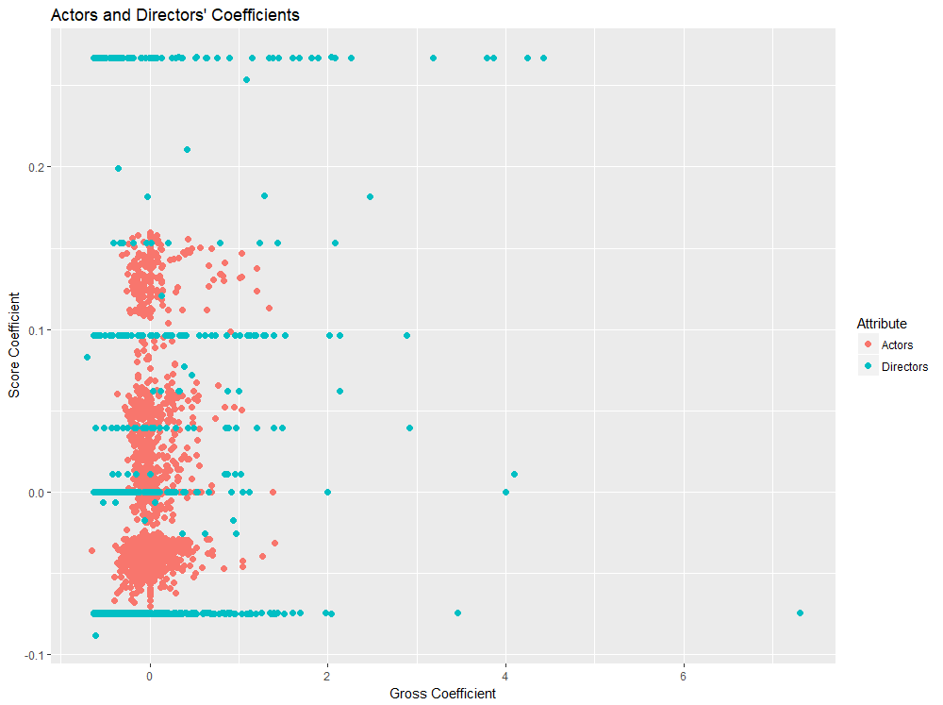
Who will make the next blockbuster?
Directors have stronger influence on gross than actors. Overall, actors’ influence on IMDb score or gross do not differ from each other really much.
There is a type of directors who have obvious positive impact on gross and IMDb score and another type who have negative impact on IMDb score but do well in gross profit.

Slide 18
Who will make the next blockbuster?
Directors who have high IMDb score and high gross
Chris Buck
Lee Unkrich
Pete Docter
Frozen
Tarzan
Finding Nemo
Monsters Inc.
Toy Story
Up
WALL.E
Joss Whedon
Christopher Nolan
Peter Jackson
The Avengers
The Dark Knight
Inception
Lord of Rings
Hobbit

Slide 19
Who will make the next blockbuster?
Directors who have low IMDb score but high gross
Colin Trevorrow
Jurassic World
Sam Raimi
Spiderman 3
Kyle Balda
Minions
Despicable Me

Slide 20
Who makes the next blockbuster?
Livvy Stubenrauch
.
.
Frozen

Slide 21
Conclusions
Budget is a vital factor leading to a blockbuster.
Facebook likes do not show obvious impact on IMDb score or gross profit.
Animation is the most outstanding genre with high IMDb score and gross.
Directors have strong impact on gross and IMDb score and those contribute to high gross can be identified.

Slide 22
Limitations
Gross is estimated data from IMDb, excluding foreign gross profit.
Genres and keywords are subjective and complex, in that every movie is a combination of several genres and keywords.
In our dataset, there are no variables evaluating movie marketing.
IMDb score is a more subjective variable compared with gross and the relationship in between is difficult to determine and analyze.

Slide 23
Resources
Data from Kaggle
PowerPoint background from MyFreePPT.com

